Slide 1

SQL Injection Protection
Kaci Craycraft & Rachel Henninger
Notes:
Rachel

Slide 2
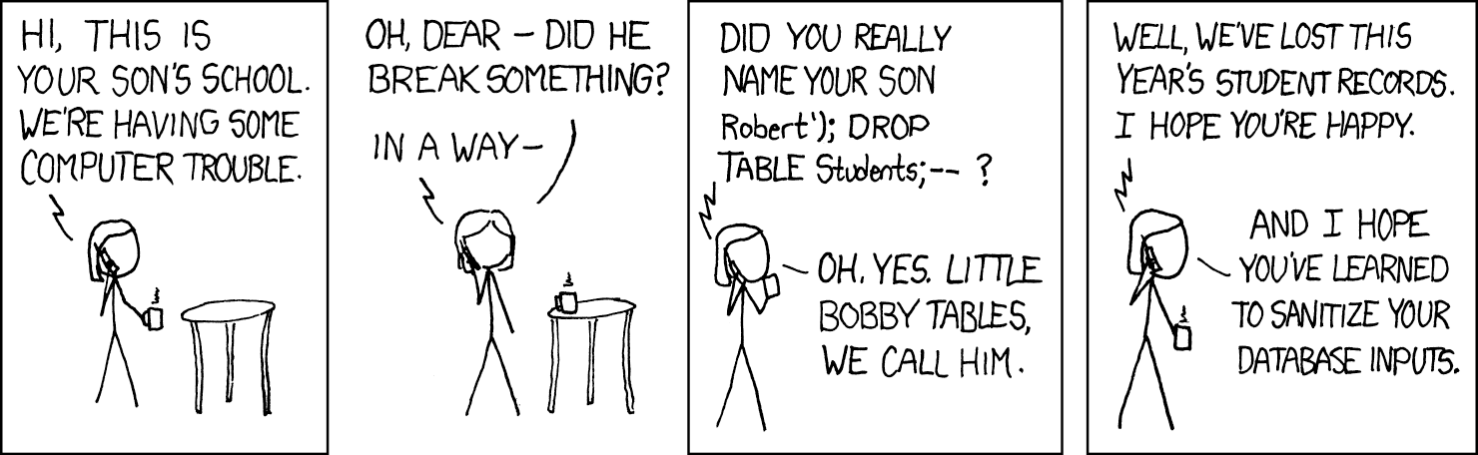
SQL Injection Attacks (SQLi)
Code injection technique that exploits vulnerabilities in applications.
Leads to unauthorized access, data manipulation, & data theft
Notes:
Rachel

Slide 3
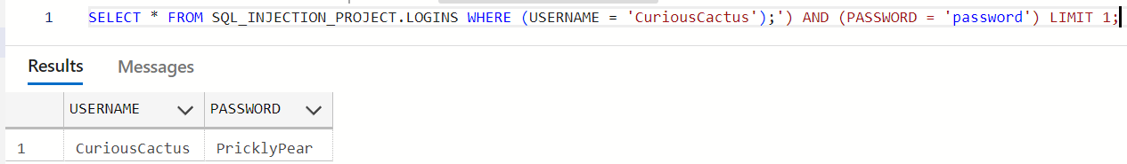
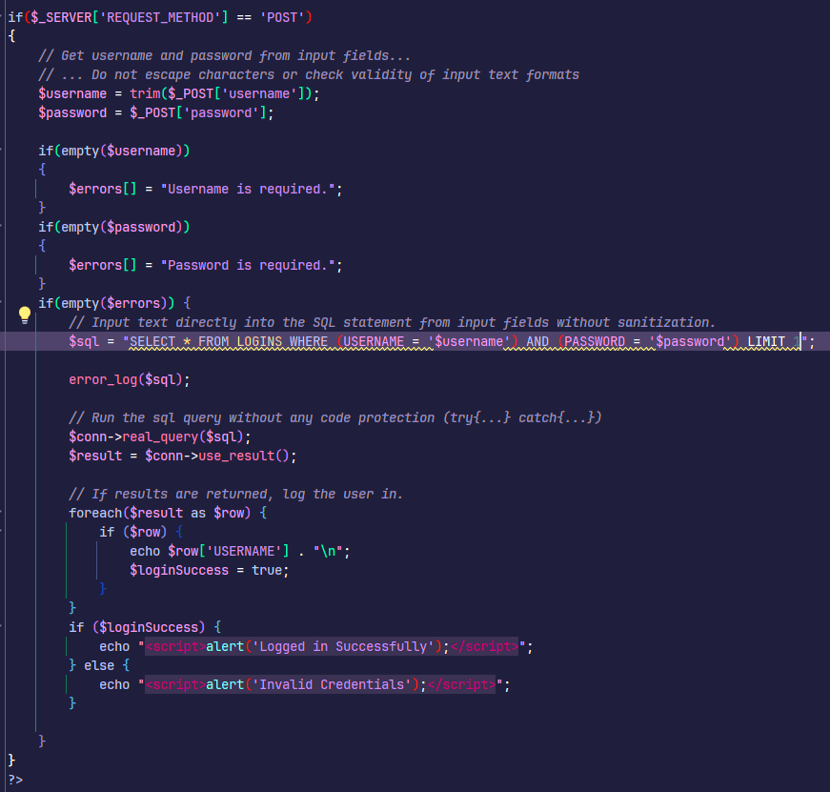
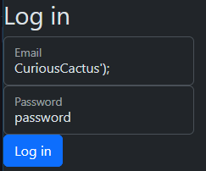
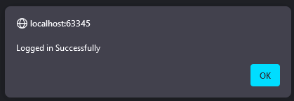
Unprotected PHP
K

Slide 4
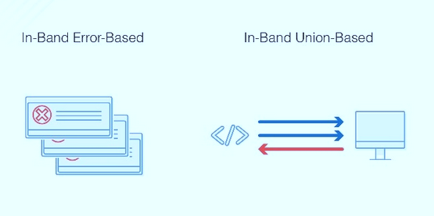
In-Band Attacks
Extremely Common
Error-Based Attacks
Union-Based Attacks
Information about the database itself including unionized data from multiple tables.
Notes:
Rachel

Slide 5

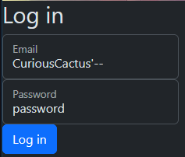
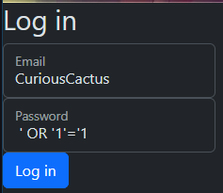
Injections
Notes:
Kaci

Slide 6
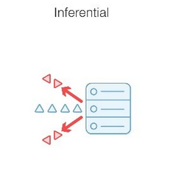
Inferential Attacks
Slower to execute, less common
Test responses and behavioral patterns in a database.
Boolean Attack – Using Boolean queries to determine if a request produces a valid or invalid response
Time Based Attack – Same basic premise, but rather than looking for a true or false, an attacker looks to see if the query waits the specified amount of time before responding.
Notes:
Kaci

Slide 7
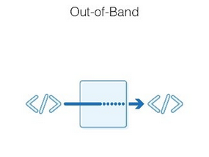
Out of Band attacks
DNS or HTTP request
Hacker acquires information through capturing requests
Notes:
Rachel

Slide 8
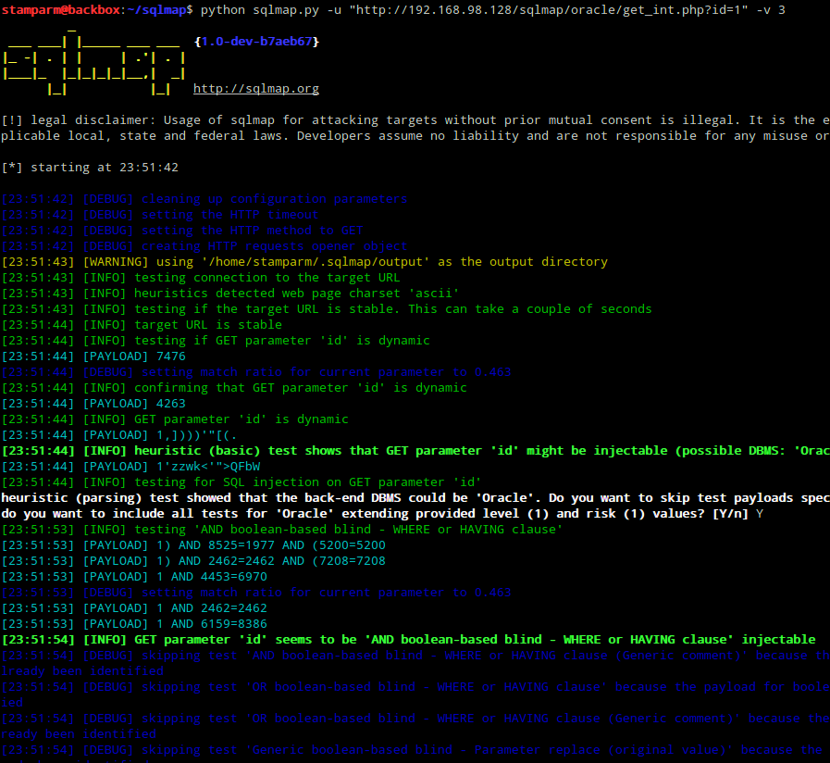
GhostShell
GhostShell in 2012
Forced awareness of cyber-security issues
SQLmap – open-source tool
European Space Agency, DOD, Chicago Federal Reserve
1.6 million usernames and passwords acquired
Notes:
Rachel

Slide 9
Prevention Importance
Security Expectations
Distrust User Input
Up-to-date versions
Routine testing
All members of projects must be educated on security expectations
Injected Statements ≠ Prepared Statements
PHP 5.6+ includes built in SQL injection protection
SQL map can test for vulnerabilities
Notes:
Kaci

Slide 10
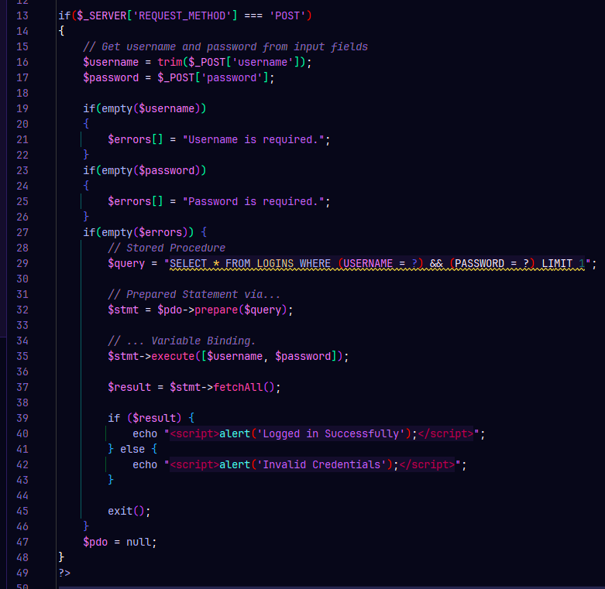
Protected Code
Notes:
Kaci

Slide 11
Thank you
Kaci Craycraft Rachel Henninger
Notes:
Conclusion - Kaci

